Slide 1
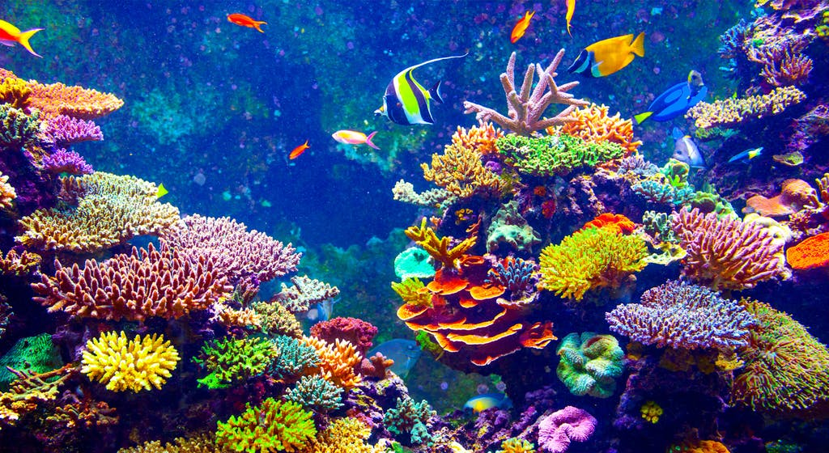
Coral Capstone

Slide 2
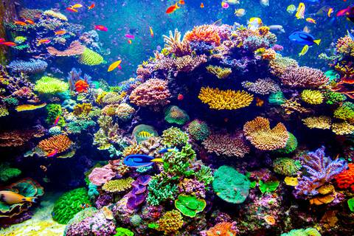
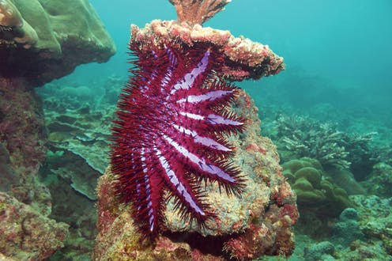
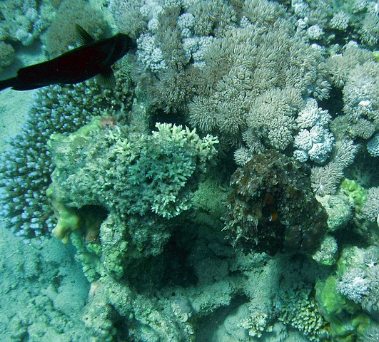
Coral Support
Shelter
Food
Regulate water chemistry
Algal support

Slide 3
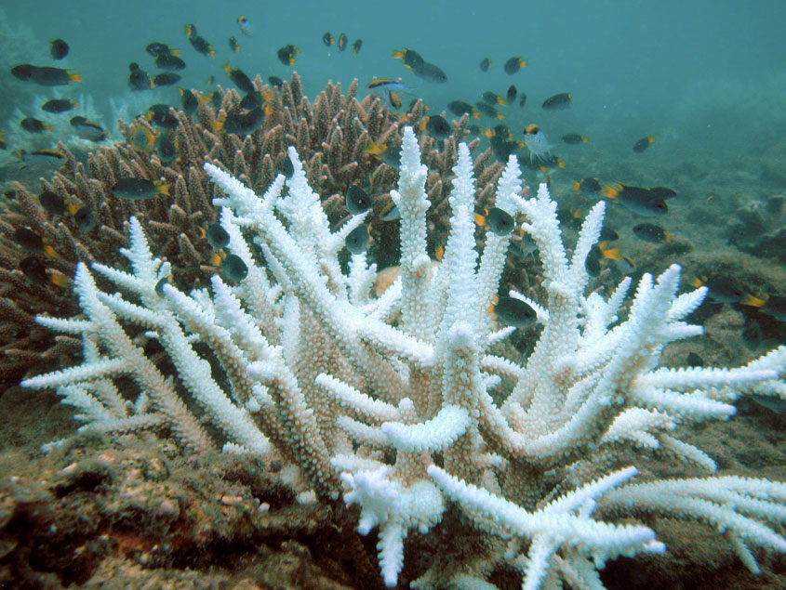
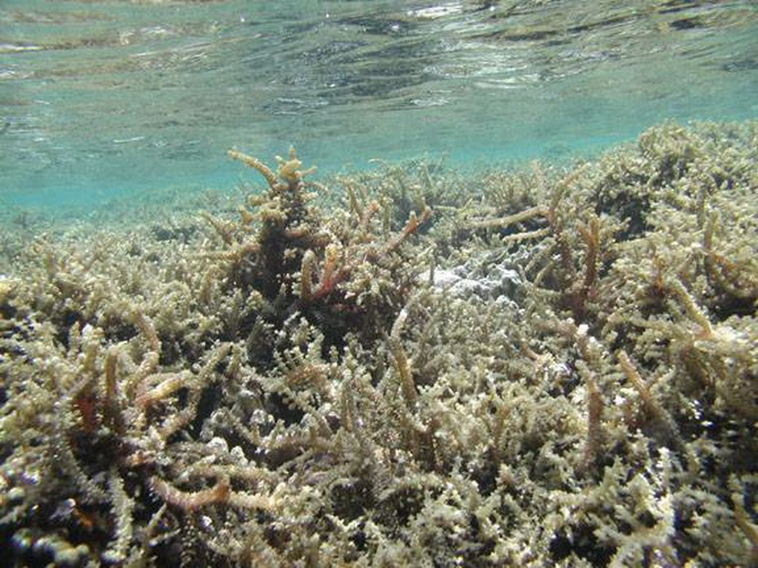
Some Threats to Corals
Rising temperatures
Ocean acidification
Increased sedimentation
Pollution
Increased salinity
Overfishing
Algal suffocation
Invasive species
Increased predation
Human activity

Slide 4

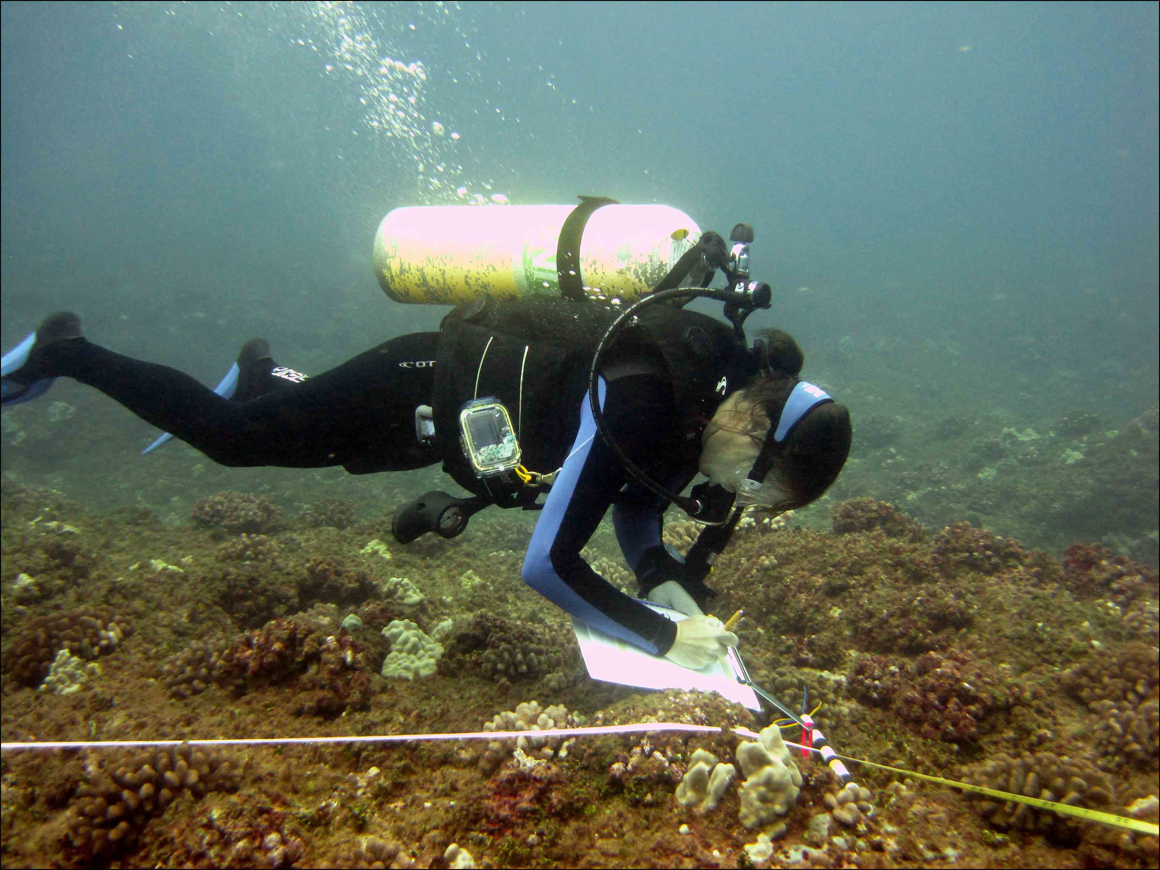
NOAA Study
Oct-03- 2005 through May-19-2012
Transect studies: 25m lines
50cm intervals: 50 data points/transect (until 2010)
20cm intervals: 125 data points/transect

Slide 5
Dataset: Initial Manipulation
31 Columns and 229,198 Rows
Data selected to use in analysis:
Latitude
Longitude
Count
Date
Year
Dummies
Region
Island
Reef zone
Exclude everything but corals
Benthic category
Datetime formatting

Slide 6
COUNT to Coral/m
Count/Day
COUNT
LPITRANSECTRUN
Transects/Day
(
(
/
(Count/Day
*2.5)
2005-2008
25m
= Coral/m
Transects/Day
(
/
(
(Count/Day)
2010-2012
25m
Transects/Day

Slide 7
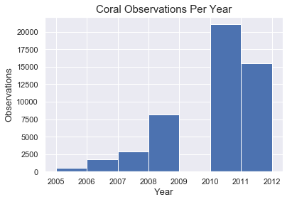

Slide 8
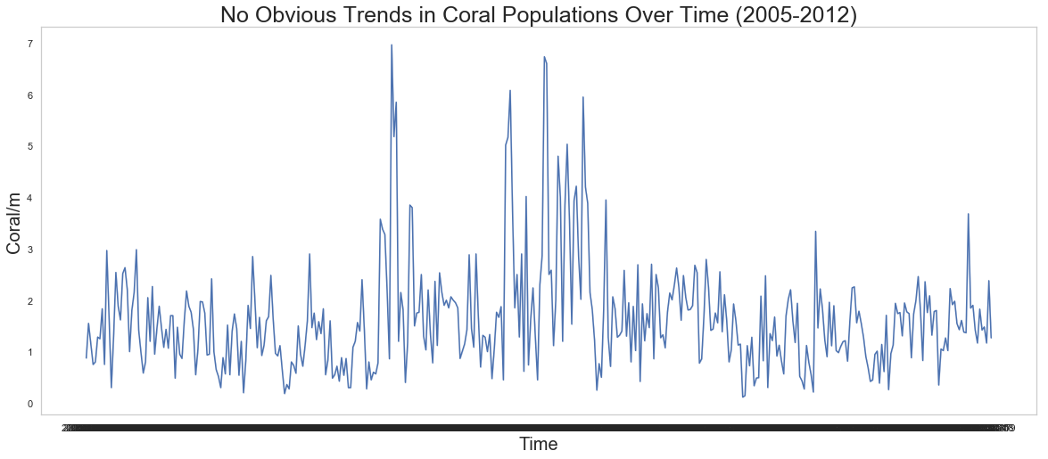

Slide 9
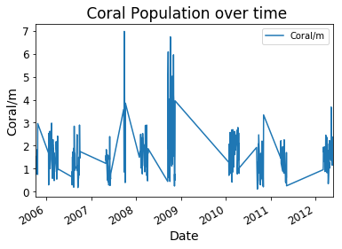

Slide 10
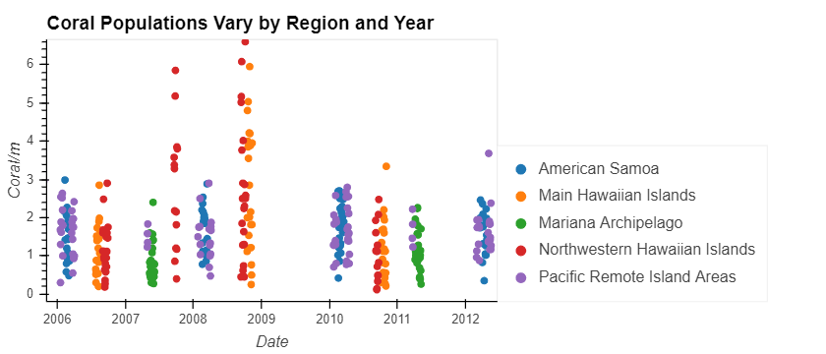

Slide 11
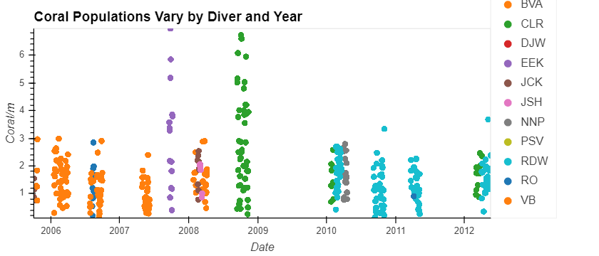

Slide 12
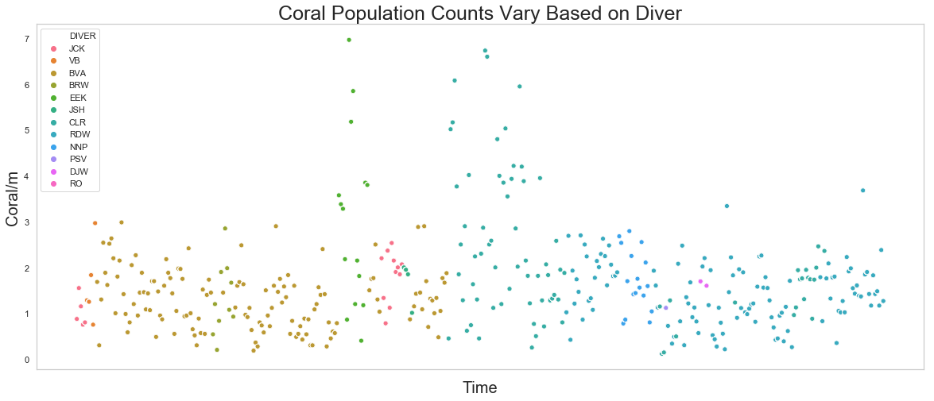

Slide 13
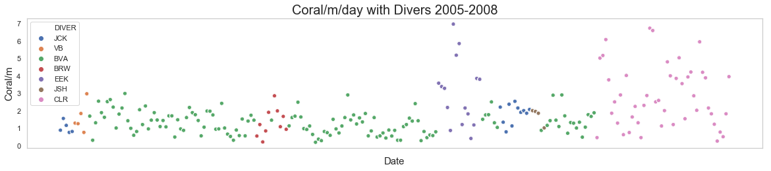
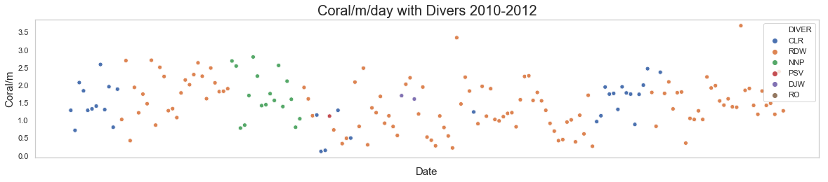

Slide 14
Modeling: Northwestern Hawaii & Pacific Remote Modeling
Linear Regression
Decision Trees
Ridge Regression

Slide 15
Feature Selection
RandForest= ensemble.RandomForestRegressor()
RandForest.fit(data,target)
RandForest.feature_importances_
RandForest_ft_series = pd.Series(data=RandForest.feature_importances_, index=data.columns)
sorted_series = RandForest_ft_series.sort_values(ascending = False)
sorted_series

Slide 16
Divers Location Year Island
BVA 2.523126e-01
LATITUDE 2.512179e-01
LONGITUDE 2.217195e-01
OBS_YEAR 1.806276e-01
CLR 2.218054e-02
Laysan 1.462313e-02
Rose 8.689676e-03
Molokai 7.596416e-03
Protected Slope 4.404341e-03
Maug 3.720406e-03
Important Features

Slide 17
Feature Selection
OBS_YEAR 3.545291e-01
LATITUDE 2.939458e-01
LONGITUDE 1.876892e-01
Lanai 2.322795e-02
Lagoon 2.066921e-02
Pearl & Hermes 1.729512e-02
Pacific Remote Island Areas 1.321357e-02
Poritidae 1.178987e-02
CLR 1.133660e-02
Niihau 9.547656e-03
Tau 6.426987e-03
Wake 5.817596e-03
JCK 4.897468e-03
American Samoa 4.479447e-03
Forereef 4.201936e-03
Baker 2.896995e-03
Oahu 2.667813e-03
Swains 2.616996e-03
BVA 2.162098e-03
Hawaii 2.075623e-03

Slide 18
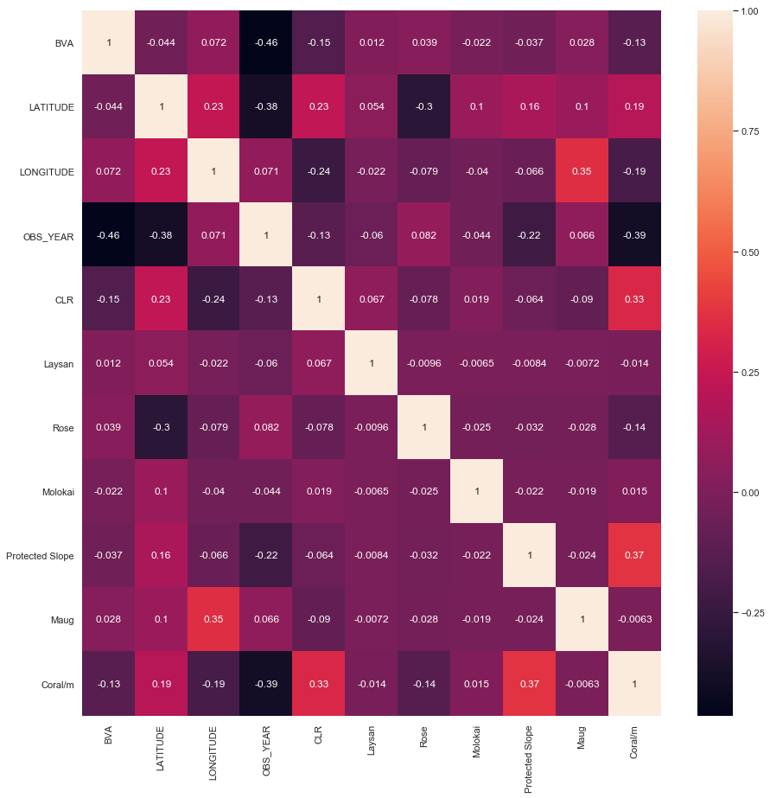
Reef zone (0.33)
Year (-0.39)

Slide 19
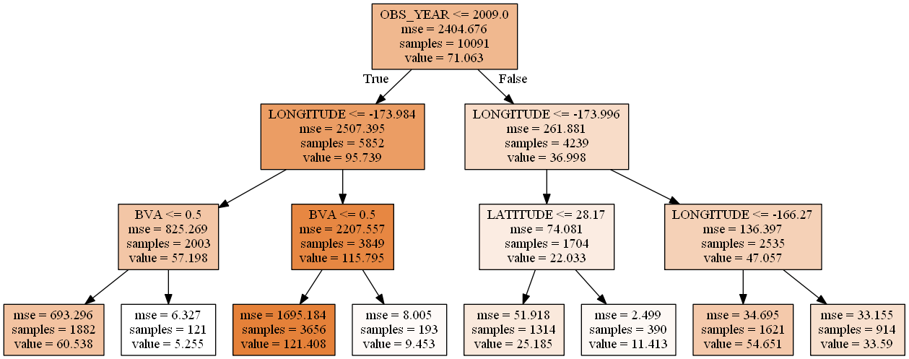
Decision Tree: Northwestern Hawaii

Slide 20
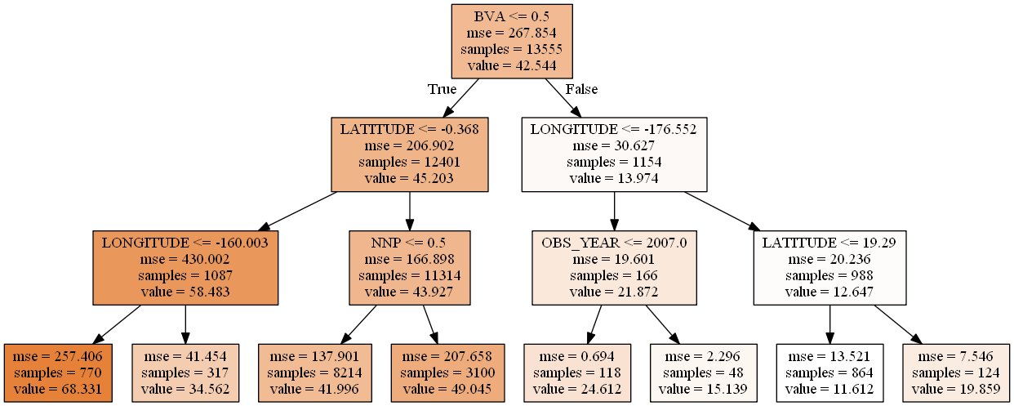
Decision Tree: Pacific Remote Islands

Slide 21
 | Northwestern Hawaii | Pacific Remote Islands
Linear Regression | Mean: -2.1996303146793205e+22 St dev: 6.598890944037961e+22 R²: 0.6847224204878828 | Mean: 0.08506574701048134 St dev: 0.2830976607597412 R²: 0.4089493286994096
Decision Tree | Mean: -0.48281950225523945 St dev: 0.6526864063514081 R²: 0.6712961980291228 | Mean: -2.3949190093535013 St dev: 5.293888417968346 R²: 0.3096593488188356
Ridge Regression | Mean: -3.3841398565514424 St dev: 5.240269079534031 R²: 0.5627893338525052 | Mean: -0.019506615957683347 St dev: 0.3935306140252425 R²: 0.3780679641656365

Slide 22
NOAA study information
Coral Reef Ecosystem Program; Pacific Islands Fisheries Science Center (2017). Pacific Reef Assessment and Monitoring Program: line-point-intercept (LPI) surveys for benthic cover at coral reef sites across the Pacific Ocean from 2005-10-03 to 2012-05-19 (NCEI Accession 0163748)

Slide 23
Code to transform count to coral/m
df['Transect/day'] = df['LPITRANSECTRUN'].groupby(df['Date']).transform('nunique’)
df['Coral/day'] = df['COUNT'].groupby(df['Date']).transform('sum’)
df_2005 = df[df['Date']<='2008-12-31']
df_2010 = df[df['Date']>'2009-12-31’]
df_2005['Coral/m']= (((df_2005['Coral/day']*2.5)/df_2005['Transect/day'])/25)
df_2010['Coral/m']= (((df_2010['Coral/day'])/df_2010['Transect/day'])/25)
df_sorted_yyyymm= pd.concat([df_2005, df_2010], axis=0)

Slide 24
Linear Regressions: NW Hawaiian vs Pacific Remote
Cross Validation:
[-2.19963031e+23 4.47113503e-01 4.10582698e-01 2.37327749e-01
-4.45101856e-01 -6.64856612e-01 -6.18348503e+00 2.88805120e-01
-6.58697128e-01 -3.18963760e+01]
Mean: -2.1996303146793205e+22
std: 6.598890944037961e+22
Coefficients:
[-1.51723539e+02 -6.01102698e+01 -3.26044922e+01 -1.21700858e+14
-1.21700858e+14 -1.21700858e+14 -1.21700858e+14 -1.21700858e+14
-1.21700858e+14 -1.21700858e+14 -1.21700858e+14 -7.52395665e+12
-7.52395665e+12 -7.52395665e+12 -7.52395665e+12 -7.52395665e+12]
Intercept:
129224814982286.31
Regression score:
0.6847224204878828
Cross Validation:
[ 0.49623217 0.35652247 0.30258355 0.16790798 -0.05772221 0.01190815
-0.5958722 0.1300612 0.06687303 -0.02783665]
Mean: 0.08506574701048134
std: 0.2830976607597412
Coefficients:
[-1.33255920e+02 -8.97963581e+01 -2.29417743e+00 2.73809679e+04
-5.97129840e+03 -5.89667109e+03 -4.56333740e+03 -3.14289610e+03
-3.88153511e+03 -3.92522981e+03 4.18520086e+00 -3.13863740e+01
3.60723430e+00 1.33078325e+01 1.02861063e+01]
Intercept:
-5199.725385690214
Regression score:
0.4089493286994096

Slide 25
Decision Trees
NW Hawaii
PRI
Cross Validation:
[ -0.23086698 -0.68232338 -0.02294144 -0.5011617 -1.83798985
-1.15797728 -1.16245421 -18.18641909 -0.14736854 -0.01968762]
Mean: -2.3949190093535013
std: 5.293888417968346
Regression score:
0.3096593488188356
Cross Validation:
[-1.94592138 -0.61856644 -0.40755521 0.3592045 -0.6141853 -0.28256268
-0.87824091 -0.80526357 0.48525344 -0.12035748]
Mean: -0.48281950225523945
std: 0.6526864063514081
Regression score:
0.6712961980291228

Slide 26
Ridge Regression
Cross Validation, PRI:
[ 0.44353744 0.3904967 0.24901078 0.04621759 -0.0918792 -0.21352105
-1.03641156 0.0907912 -0.03733386 -0.03597419]
Mean, PRI: -0.019506615957683347
STdv PRI: 0.3935306140252425
Coefficients, PRI:
[-4.64919222e-01 1.31931779e-02 2.27949930e-02 5.97697909e-01
-1.81768322e+00 4.76131499e+00 1.76895501e-01 3.84869158e+00
-4.04354775e+00 -3.01535173e+00 1.15158483e+01 -2.60362873e+01
-1.58559371e+00 1.19965843e+01 4.61746567e+00]
Intercept, PRI:
0.0
Regression score, PRI:
0.3780679641656365
Cross Validation, NW:
[ 0.2971182 0.44734407 0.09183082 0.16247864 -1.91413679
-0.43620401 -13.39785376 -0.54432759 -5.20292734 -13.3447208 ]
Mean, NW: -3.3841398565514424
STdv NW: 5.240269079534031
Coefficients, NW:
[-127.20301601 -51.07660314 -2.70654219 34.08790485 -41.71808183
-35.26657522 -79.15966129 47.0273953 20.49561135 41.73182075
17.69493498 -53.08662476 44.19850957 28.79045299 -10.18451967
-4.82446924]
Intercept, NW:
0.0
Regression score, NW:
0.5627893338525052

